Slide 1

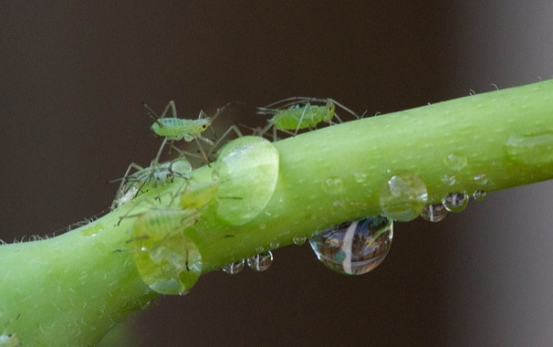
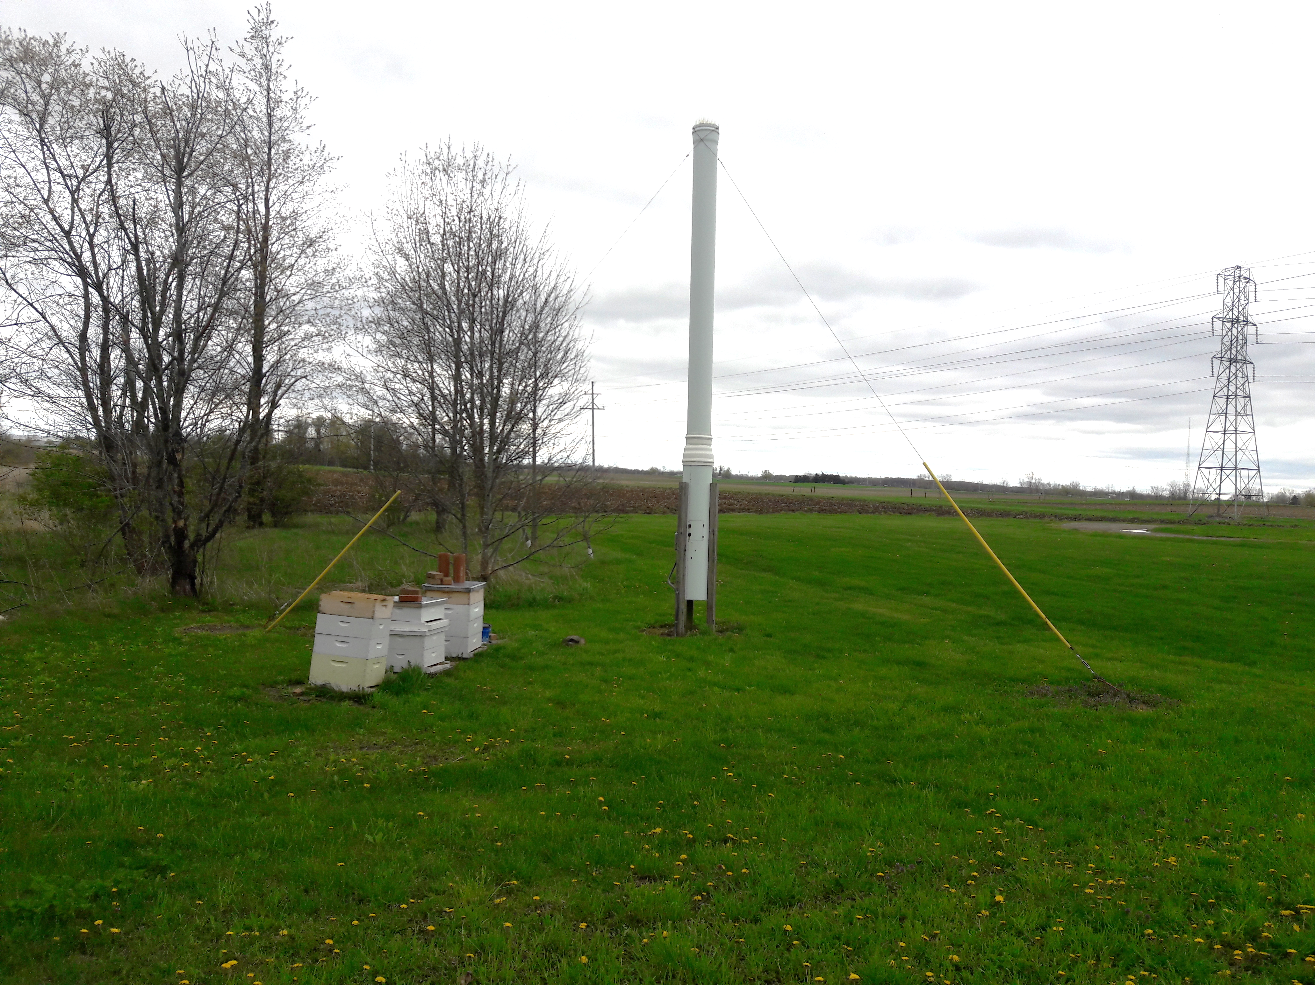
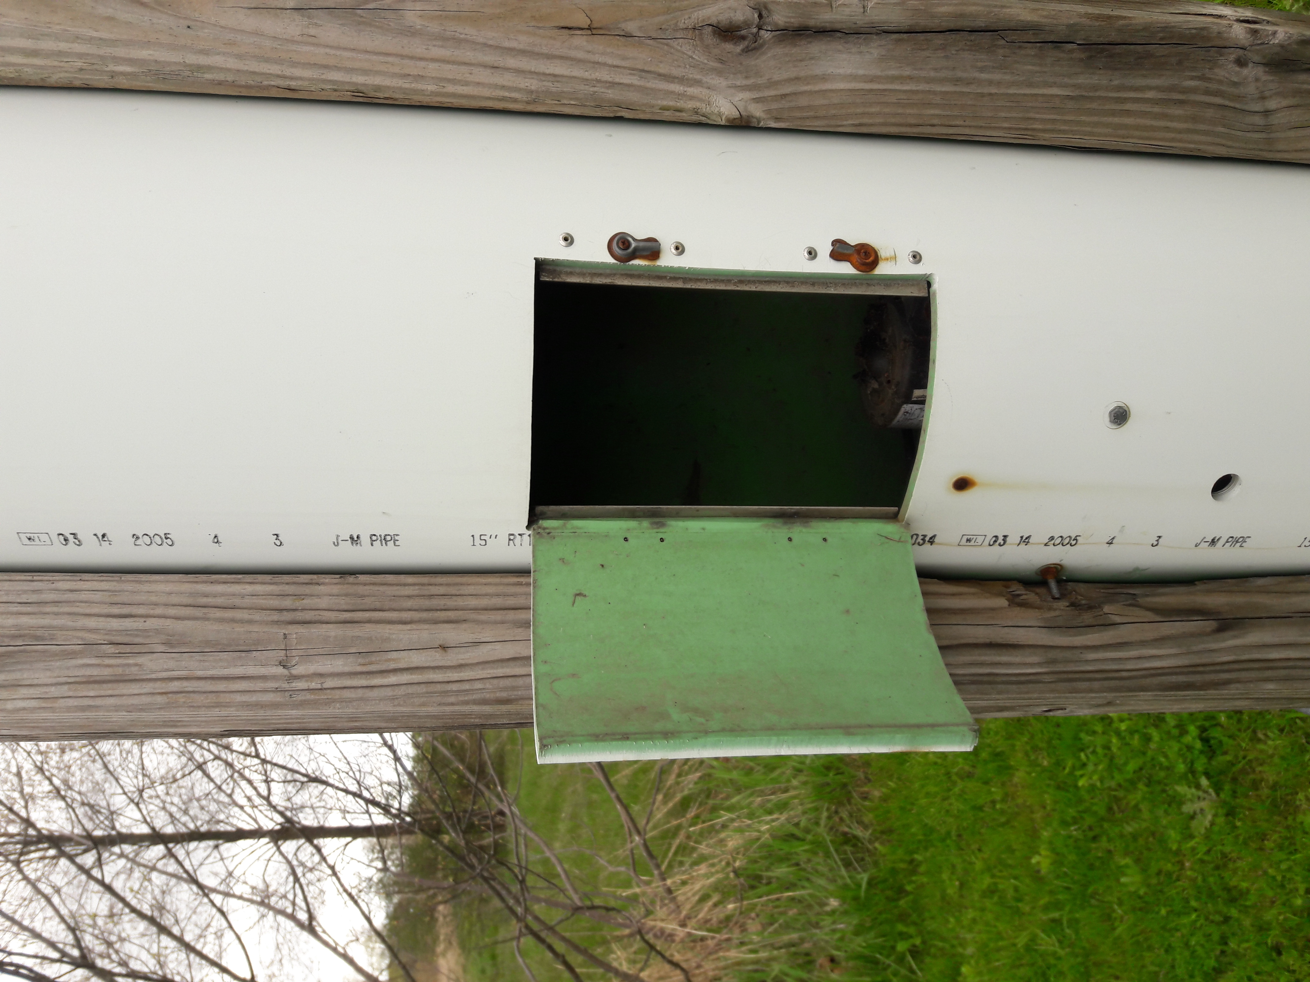
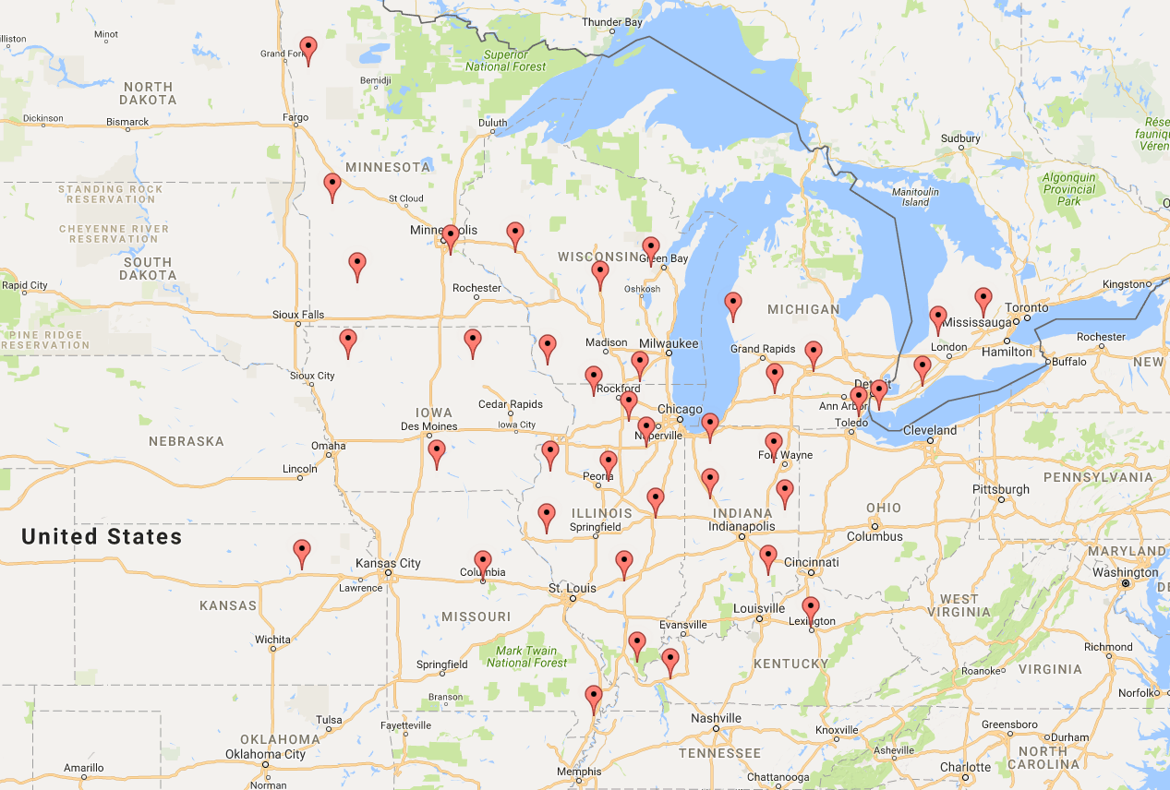
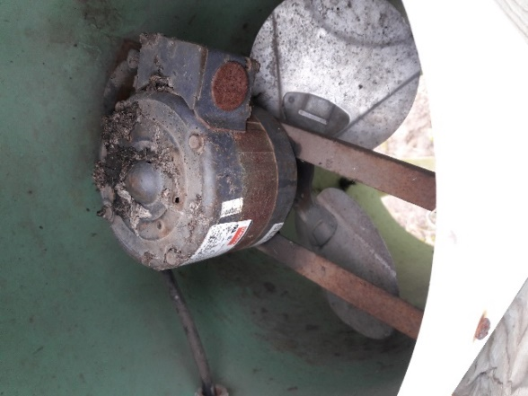

Environmental variation influences aphid community structure over large spatial and temporal scales
Savvas Constantinou^{1,2}, Courtney Larson^{2,3}, Isaac Osei-Bonsu⁴, Braeden Van Deynze⁵, Chad R. Zirbel^{2,4}, Doris Lagos-Kutz⁶, David Voegtlin⁶ and Christie A. Bahlai^{1,2}
Photo Credit:Steve Bittinger
(1)Integrative Biology, Michigan State University, East Lansing, MI, (2)Program in Ecology, Evolutionary Biology and Behavior, Michigan State University, East Lansing, MI, (3)Entomology, Michigan State University, East Lansing, MI, (4)Plant Biology, Michigan State University, East Lansing, MI, (5)Agriculture, Food and Resource Economics, Michigan State University, East Lansing, MI, (6)Crop Sciences, University of Illinois, Urbana, IL
Introduction
Results
Aphids are ubiquitous herbivores, and many species act as pests on economically important crops.
Understanding the distribution, abundance, and diversity of pest aphid species help to inform crop management practices.
The goal of this study was to determine the effect of environmental variation over large, regional spatial and temporal scales on aphid community structure.
714,500 individuals were captured across 230 aphid species comprising 73 genera over the 9 year period.
Aphid communities were variable over time, with differences between years and across spatial scales (PERMANOVA, p<0.01).
Methodology
Fig. 1: Nonmetric multidimensional scaling (NMDS) of aphid species composition by year.
Fig. 2: NMDS of aphid species composition by state
An aphid trap at MSU Entomology farm, East Lansing
Map showing aphid trap sites
Aphid suction traps were placed over agricultural fields spanning the states of Iowa, Illinois, Indiana, Kansas, Kentucky, Michigan, Minnesota, Missouri, South Dakota, and Wisconsin.
Traps were checked every seven days from April-December over the period 2005 – 2013, and insects were identified to the highest taxonomic precision possible (usually species)
Cropland data was access from National Agricultural Statistical Services (NASS) Cropland Data Layer (CDL) program (https://www.nass.usda.gov/Research_and_Science/Cropland/SARS1a.php)¹ .
Weather data was accessed through PRISM (http://www.prism.oregonstate.edu/)
Data was analyzed using R v 3.3.0. All R code and data are available on Github: https://github.com/ReproducibleQM/sapsuckRz
Fig 3: Abundance of top ten aphids over the 9 year period. Data from the Soybean aphid is shown in the insert graph allow for trends in other species to be seen.
Conclusions
Future Directions
Soybean aphid (A. glycine) was the most abundant species at the start of experiment but declined with time.
Corn leaf aphid (R. maidis) and bird cherry-oat aphid (R. Padi) had dominant activity peaks mid-season for most of the years
Aphids varied by state, but communities strongly overlapped
Model the effect of environmental factors (rainfall and temperature) on the abundance of aphid species
Determine influence of cropland cover on species composition and abundance
References
Boryan, C., Yang, Z., Mueller, R. & M. Craig (2011) Monitoring US agriculture: the US Department of Agriculture, National Agricultural Statistics Service, Cropland Data Layer Program, Geocarto International, 26:5, 341-358, DOI: 10.1080/10106049.2011.562309
Tilmon K.J, E. W. Hodgson,2 M. E. O’Neal,2 AND D. W. Ragsdale (2011) Biology of the Soybean Aphid, Aphis glycines(Hemiptera: Aphididae) in the United States. J. Integ. Pest Mngmt. 2(2); DOI: http://dx.doi.org/10.1603/IPM10016
*Contact: ioseibonsu@aol.com
Acknowledgements
This poster was produced based on work completed in Reproducible Quantitative Methods, a graduate class supported by the MSU-EEBB program in spring semester 2017

